Slide 1
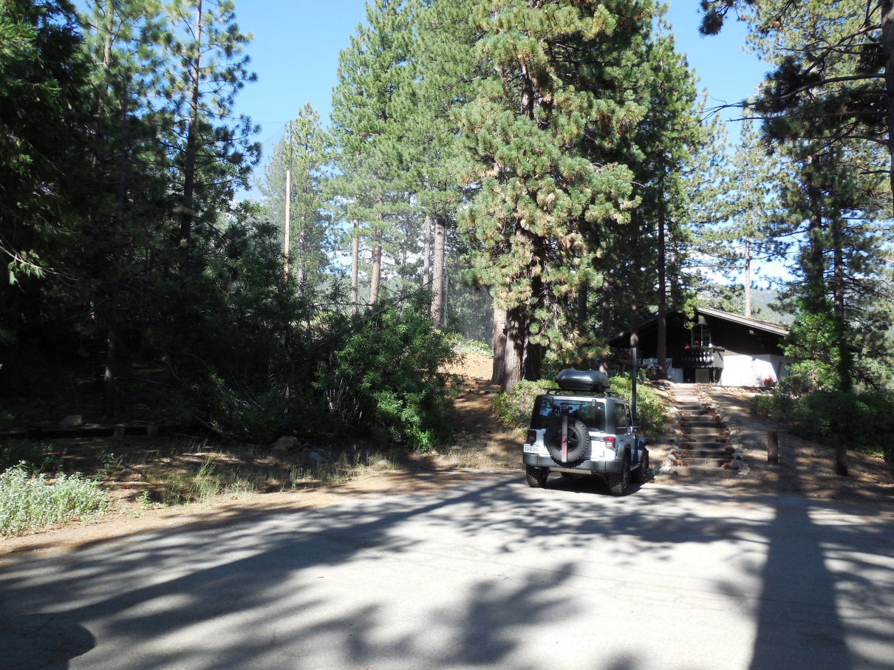
WPVAR-0006 Chalets
Washoe County Board of Adjustment
August 3, 2017

Slide 2
Overview
6 unit condominium development built in 1969
Stream Environment Zone (SEZ) traverses site
Parking area covers a portion of SEZ
Abuts the driving range of Incline Village Championship Golf Course
Provide protection from golf balls

Slide 3
Site Plan
Edge of Road
Driving Range
Construct 5 bay carport 3’- 8” from front property line.
Remove coverage from SEZ and relocate to higher capability land.
Carport
Property Line

Slide 4
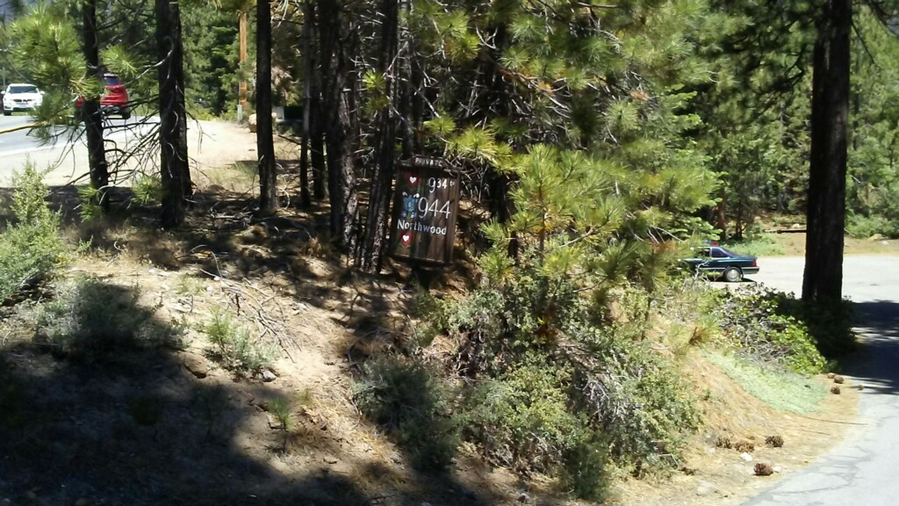
Site Photo
Approximately 40 feet from edge of pavement to location of carport
Road is + 16 feet above parking area

Slide 5
Public Notice & CAB
Sixty notices were mail to the surrounding property owners within 500 feet
Notice mailed on July 21, 2017
Incline Village/Crystal Bay CAB reviewed on July 24, 2017
Gerry Eck recused
CAB voted to recommend approval
Motion passed unanimously

Slide 6
Commenting Agencies
Washoe County Community Service
Planning and Building Division
Planning Section
Engineering and Capital Projects
Land Development
Incline Roads

Slide 7
Findings
Special Circumstances. Because of the special circumstances applicable to the property, including extraordinary and exceptional situation or condition of the property and/or location of surroundings; the strict application of the regulation results in exceptional and undue hardships;
No Detriment.
No Special Privileges.
Use Authorized.

Slide 8
Possible Motion
I move that, after giving reasoned consideration to the information contained in the staff report and information received during the public hearing, the Washoe County Board of Adjustment approve Variance Case Number WPVAR17-0006, with the conditions included as Exhibit A for this matter, for The Chalets HOA, having made all four findings in accordance with Washoe County Code Section 110.804.25

